Slide 1
A Presentation on Quantum Computing
BS-CS Batch 22
Intro to ICT Presentation
By Ibrahim Awais, Muhammad Taha, Ahmed Asif, Saifullah Imran

Slide 2
Table of contents
01
02
03
04
Today’s Computers
Limits of Computers
What are they and how do they work?
Why we might need other alternatives
Intro to Quantum Computers
Future Possibilities
A possible answer
How far along are we?

Slide 3
01
Today’s Computers
Presenter: Ibrahim Awais

Slide 4
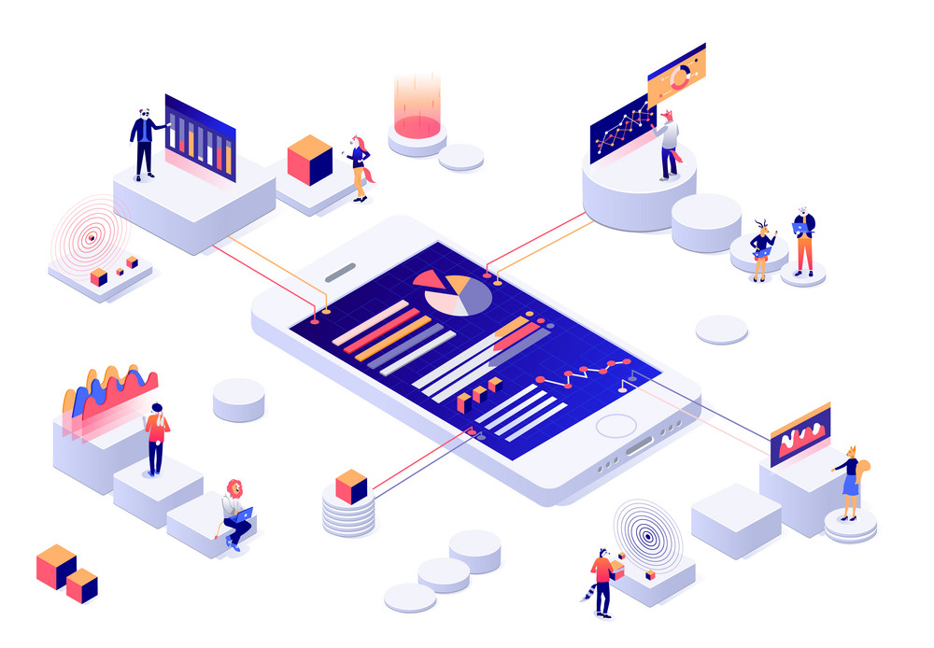
Today’s Computers
Made up of very simple components
doing very simple things:
1. Storing Data 2. Processing Data 3. Controlling Data
Handled with Processors

Slide 5
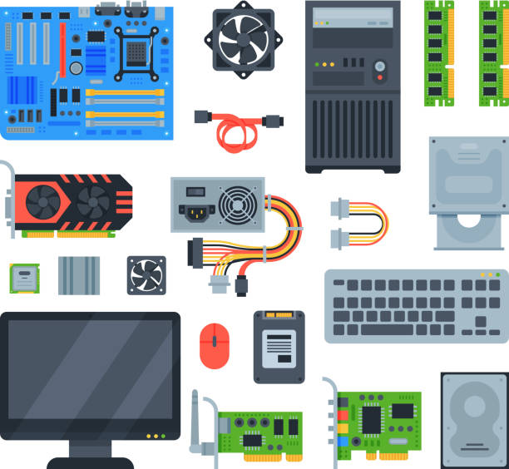

Slide 6
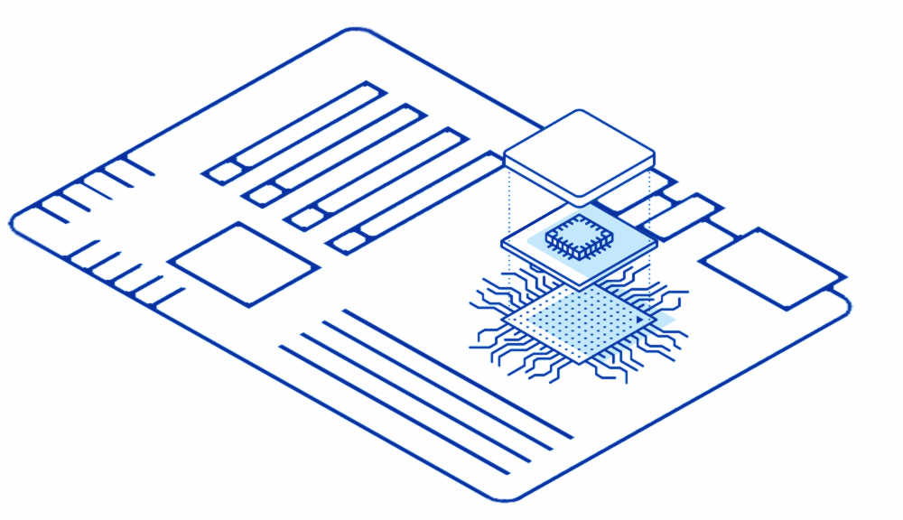
CPU

Slide 7





The parts of a CPU
Processor
Logic Gates
Registers
Transistors
Made of
Which guide
Electrons
Has
Combinations of

Slide 8


Slide 9

Computers are just electricity that can do Maths
Transistors are just electrical levers

Slide 10
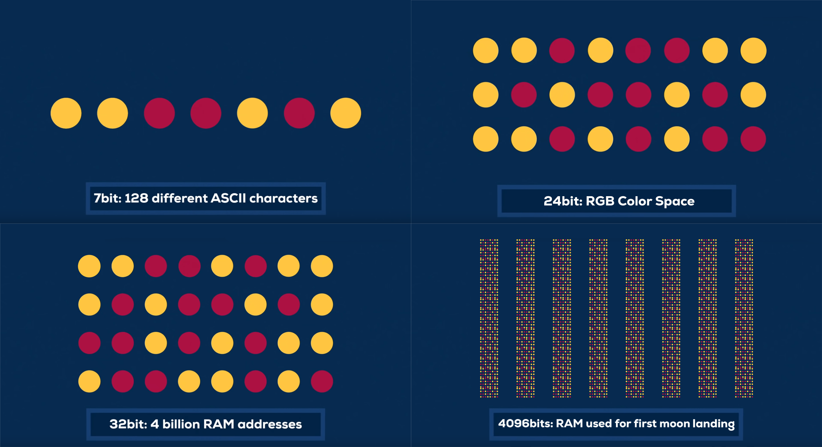

Slide 11
02
Limits of Computers
Presenter: Muhammad Taha

Slide 12
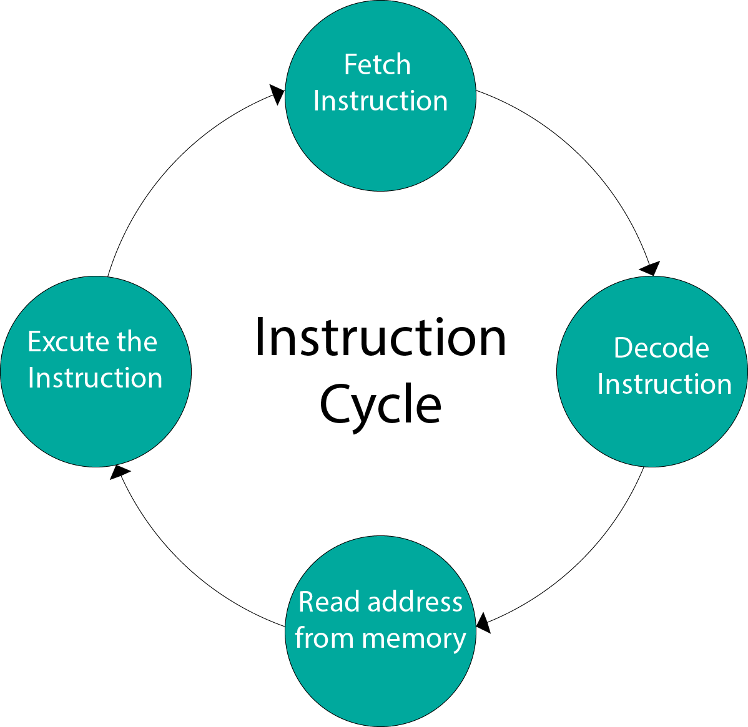
Processing Data
Computers are limited in
processing data.
Fetch and execution can’t
be simultaneous
Most time is spent in fetching
Limits large-scale operations

Slide 13
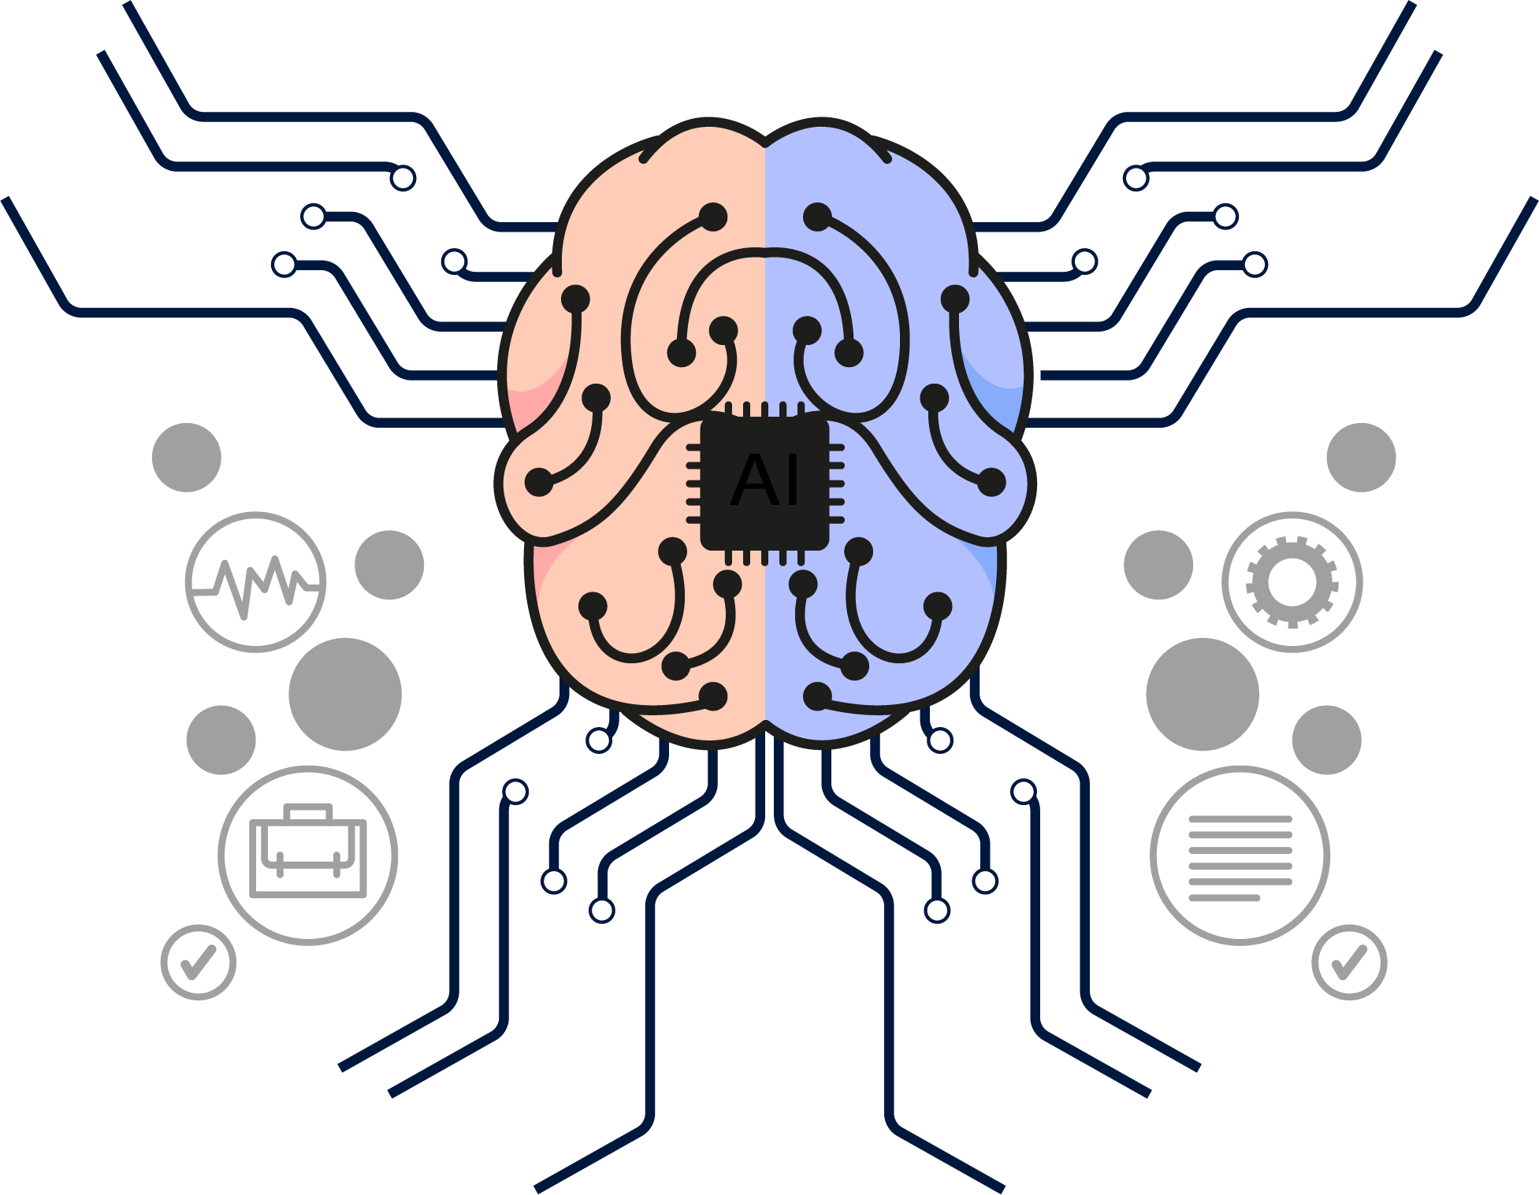

Slide 14
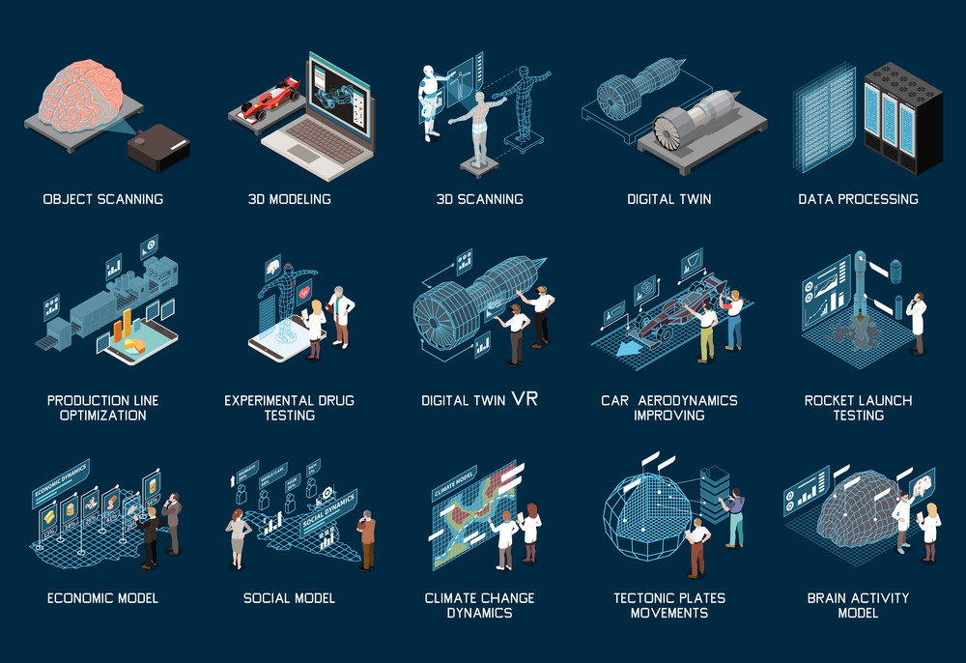

Slide 15


Size of transistors
7 nm
Transistors have halved in size every 2 years
Current transistors are 7nm
Approaching the size of an atom
7000 nm

Slide 16


Slide 17
03
Intro to Quantum Computers
Presenter: Saifullah Imran

Slide 18
Quantum Computing
Refers to principles of Quantum Physics
Main principles of Quantum Physics are:
Superposition
Quantum Interference
Entanglement

Slide 19
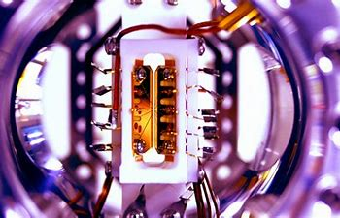
Quantum Computing and Atoms
Atom computing is building a high reputation
World’s most scalable Quantum Computers
Uses Strontium Atoms

Slide 20
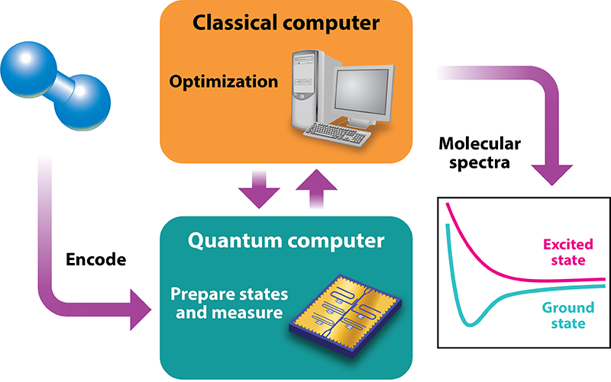
Comparison with Classic Computers
Uses Qubits which can represent both ‘0’ and ‘1’ simultaneously
Can handle calculations much faster

Slide 21
Pros and Cons
Pros
Cons
Extremely fast and effective
Can solve Complex Problems
Can evaluate Complex Stimulations
Hard to Control
Complex Hardware Schemes
Qubits are not digital, so they can’t be used for error correction.

Slide 22

Future Possibilities
Presenter: Ahmed Asif

Slide 23
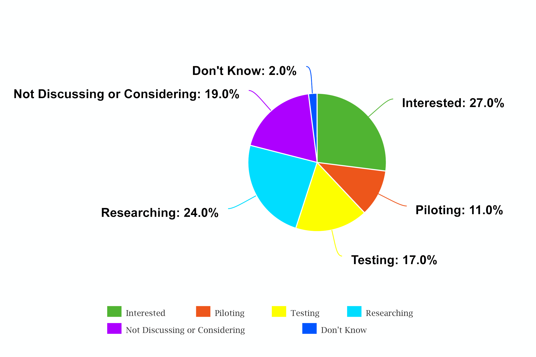
ESG IT Survey

Slide 24
Future Uses
Quantum Cognition:
Model concepts such as
Human Brain
Language
Decision Making
Human Memory
Conceptual Reasoning
Quantum Cryptography:
Develop secure encryption methods by taking advantage of quantum mechanical properties.

Slide 25
Future Uses
Quantum Optics:
Examine interactions of photons with particles and atoms
Quantum Neural Networks:
Combination of Classical Artificial Neural Network models with advantages of Quantum Computing to develop efficient algorithms.

Slide 26
Conclusion
Do you have any questions?
i220001@nu.edu.pk
+92 111 241 241
csjournal.readthedocs.io
A presentation by:
Ibrahim Awais
Muhammad Taha Ahmed Asif
Saifullah Imran

